Slide 1
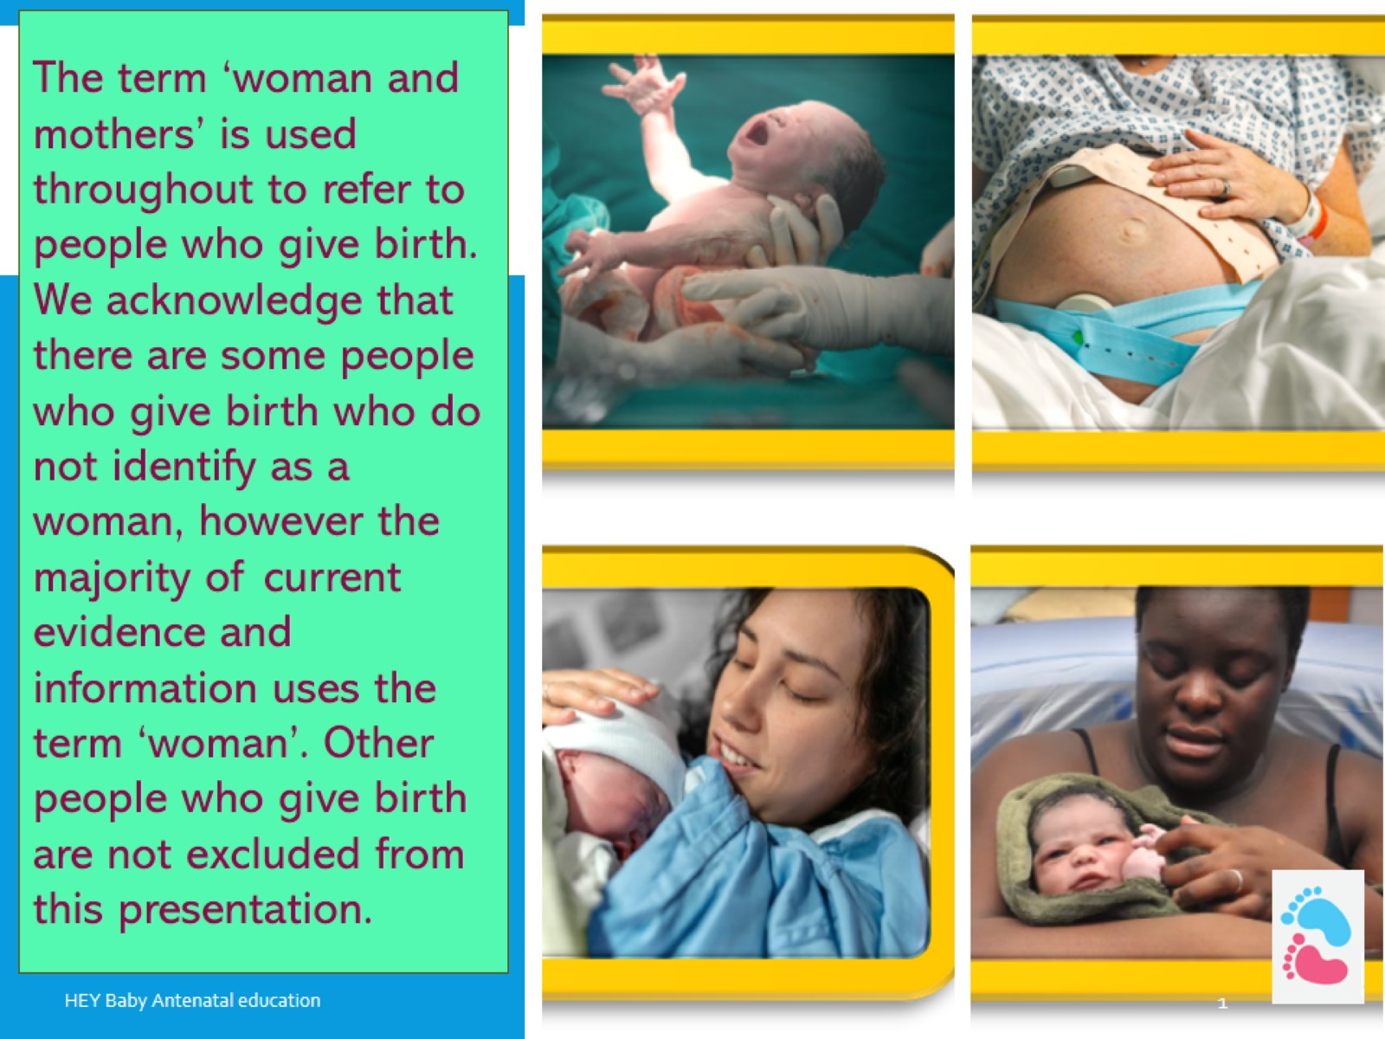

Slide 2
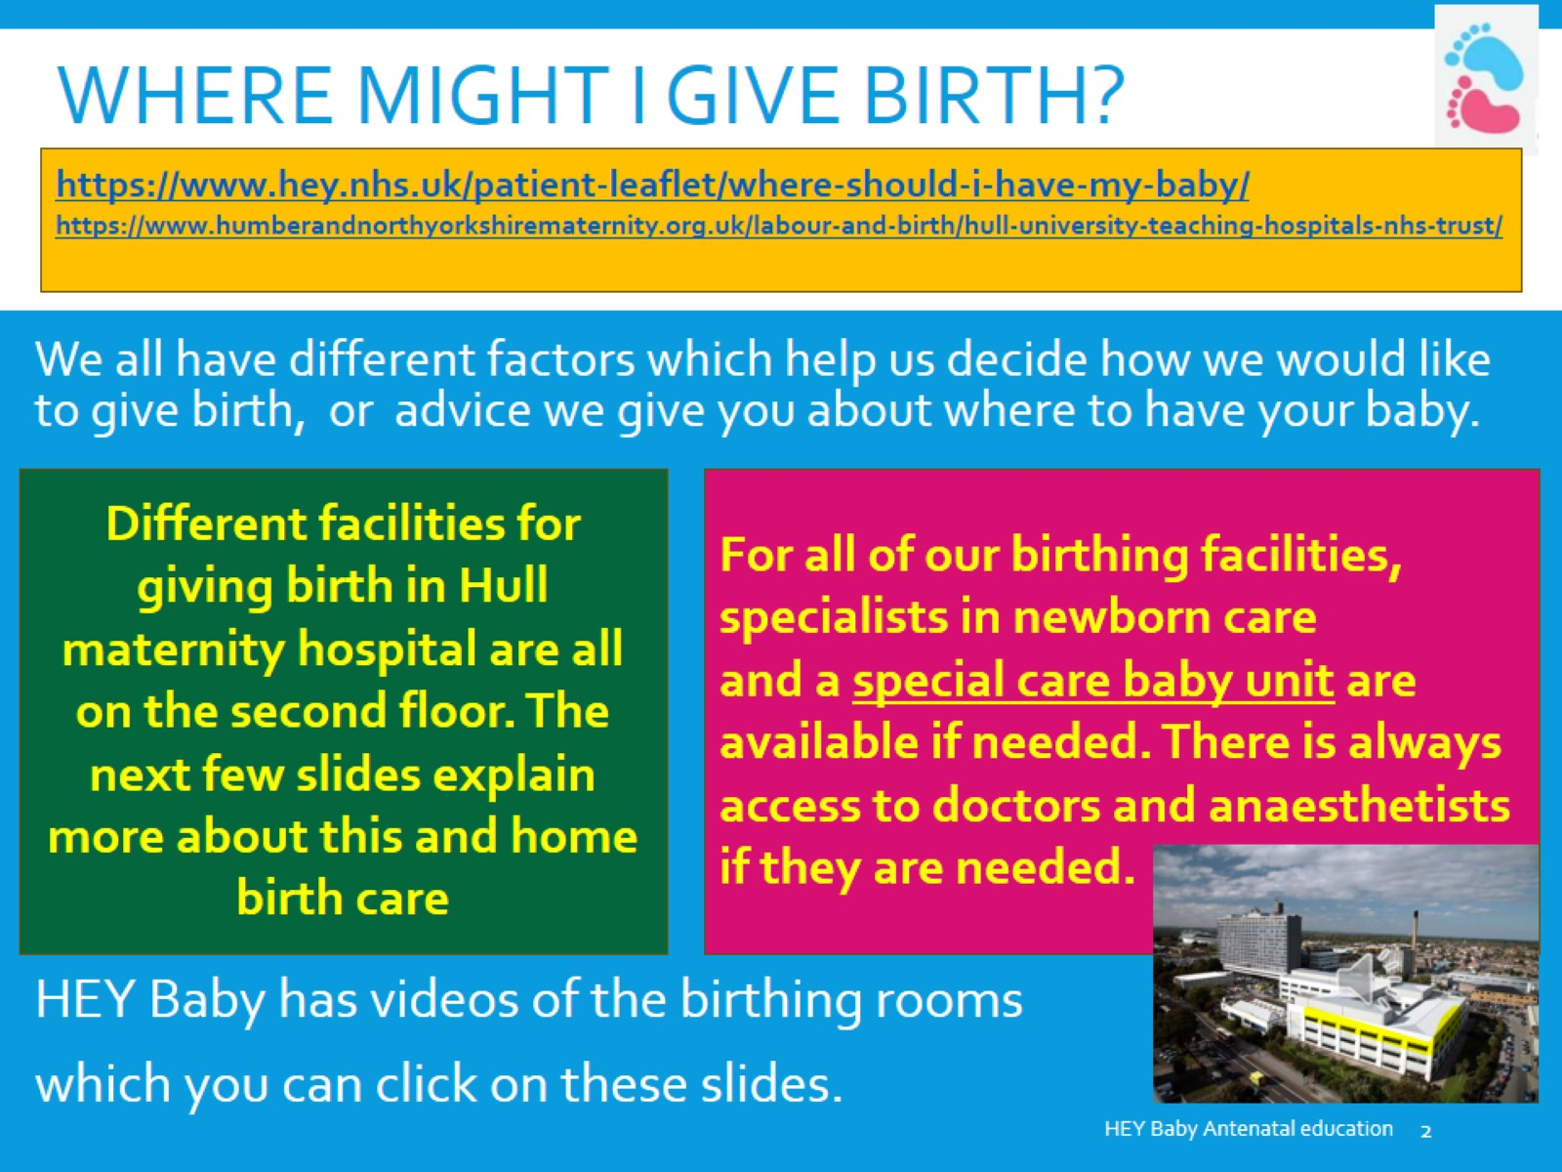
Where might I give birth?

Slide 3
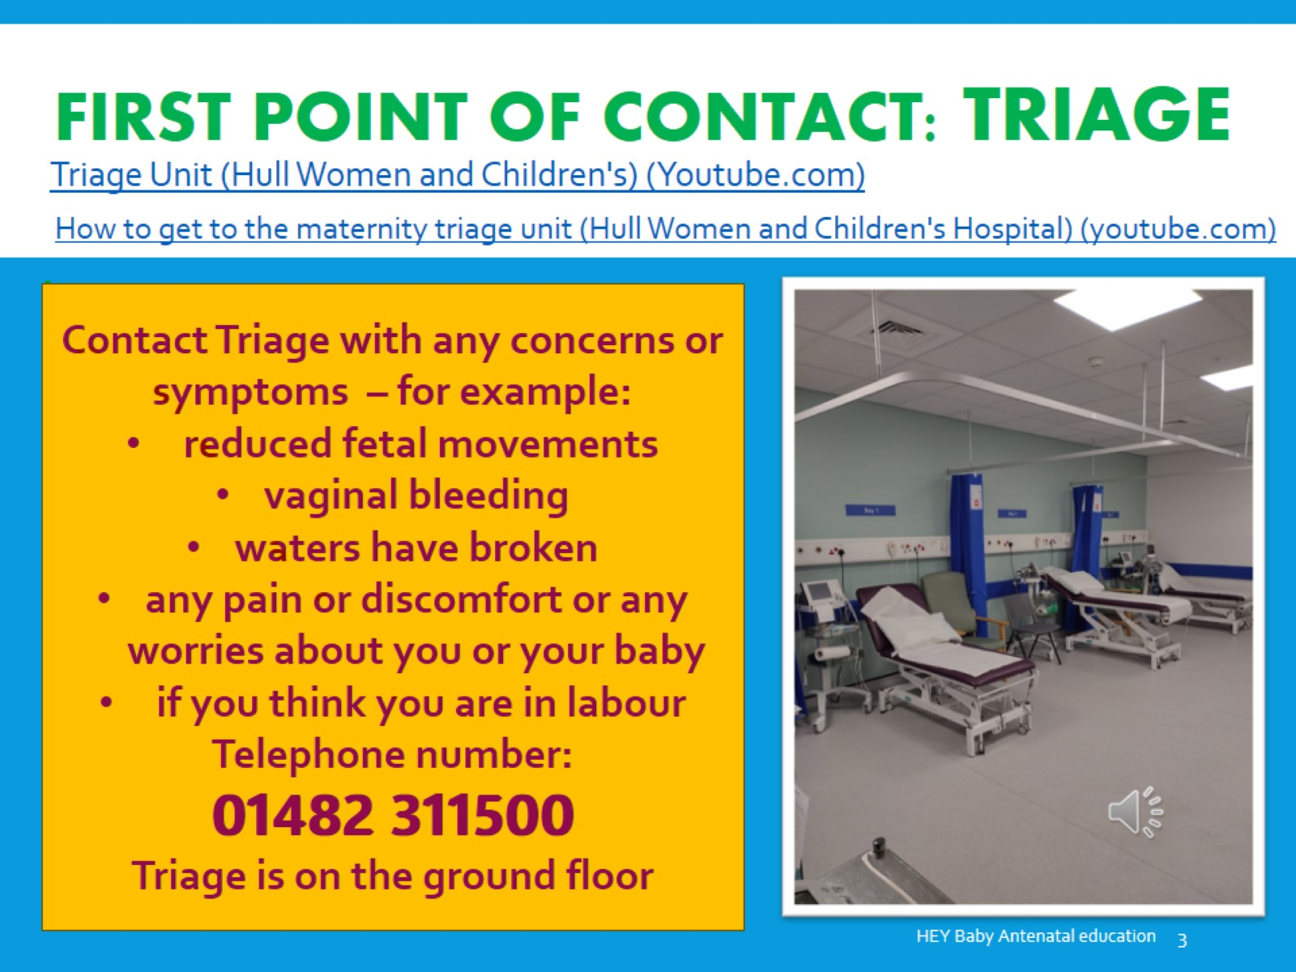
First point of contact: triage

Slide 4
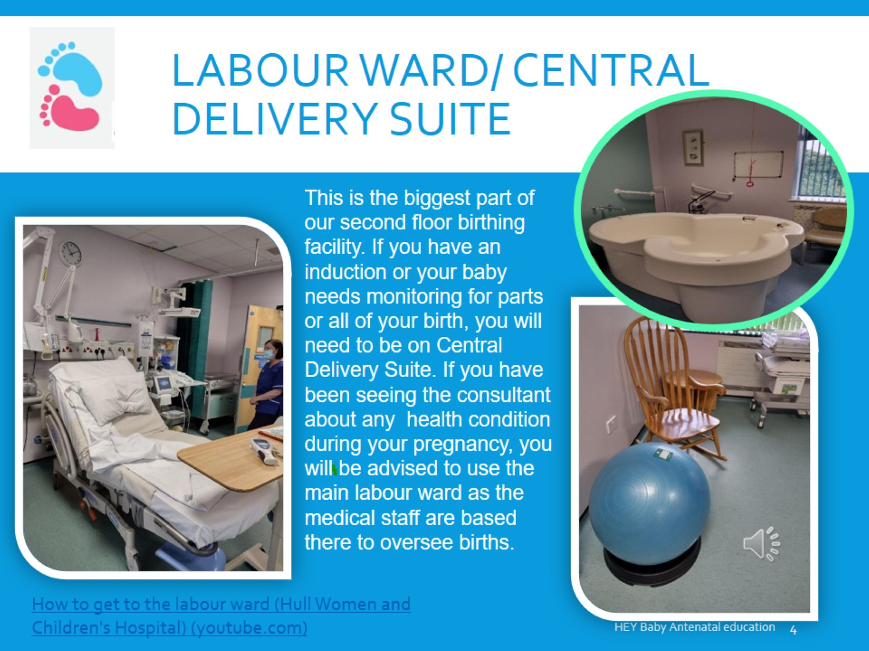
Labour ward/ central delivery suite

Slide 5
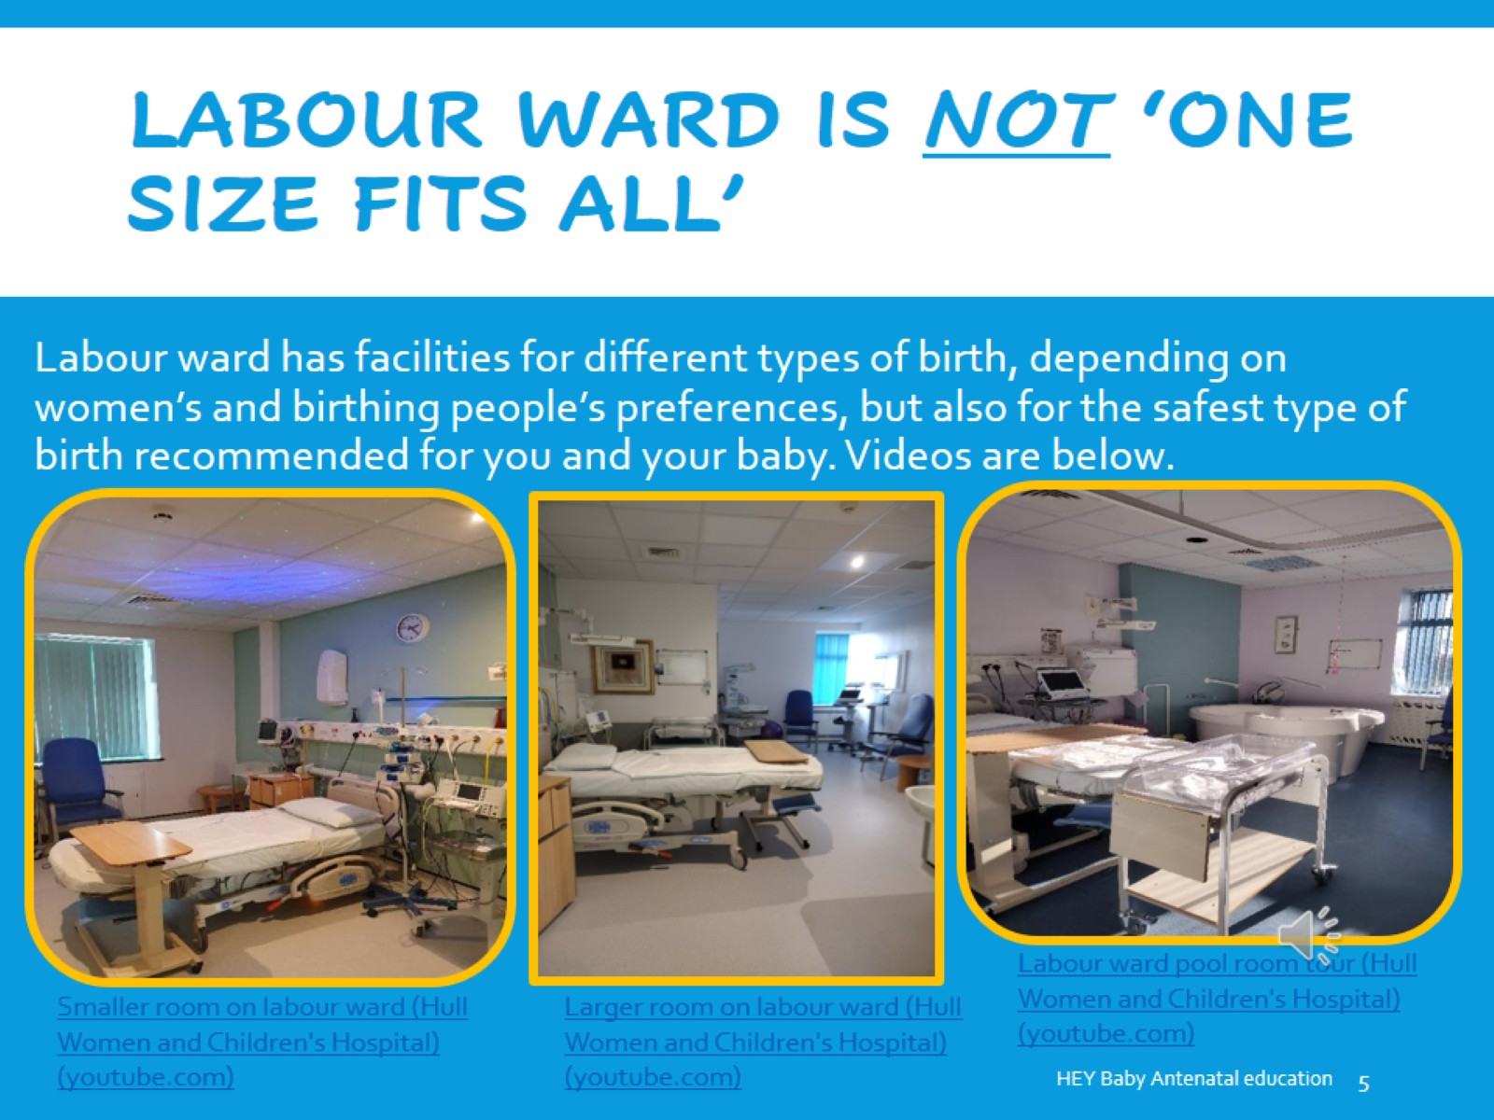
Labour Ward is not ‘one size fits all’

Slide 6
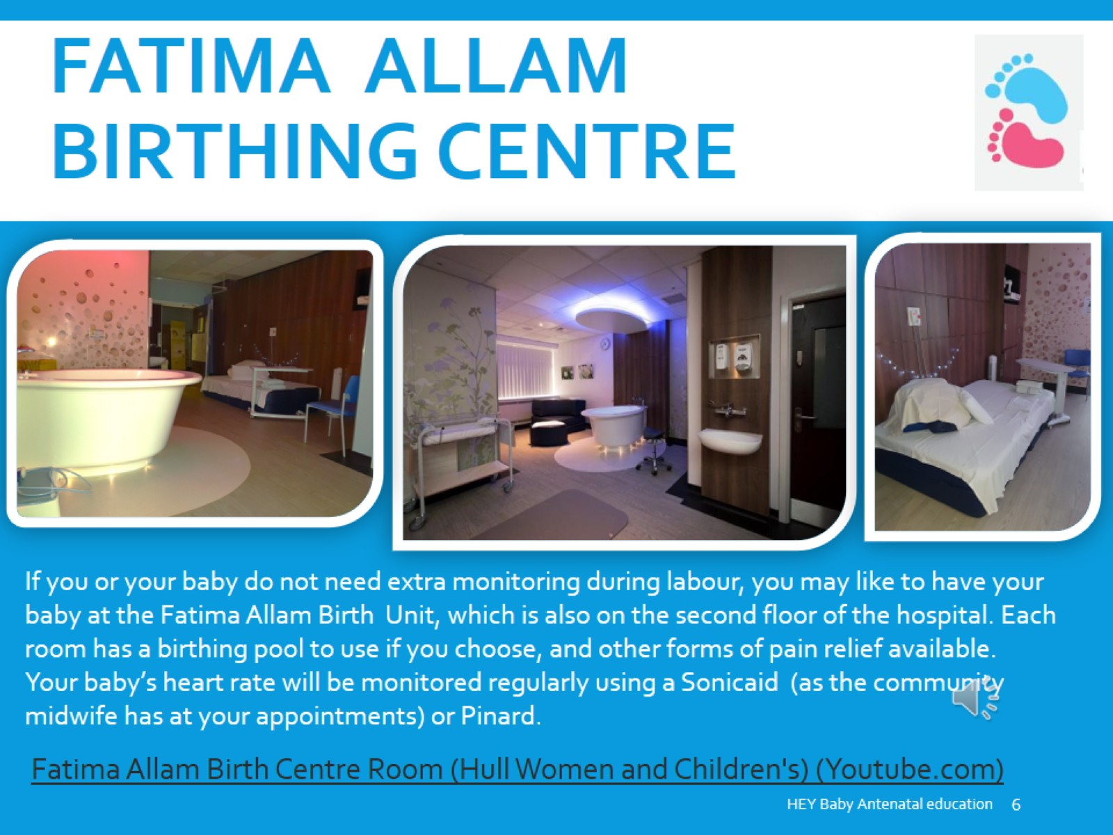
Fatima allam birthing centre

Slide 7
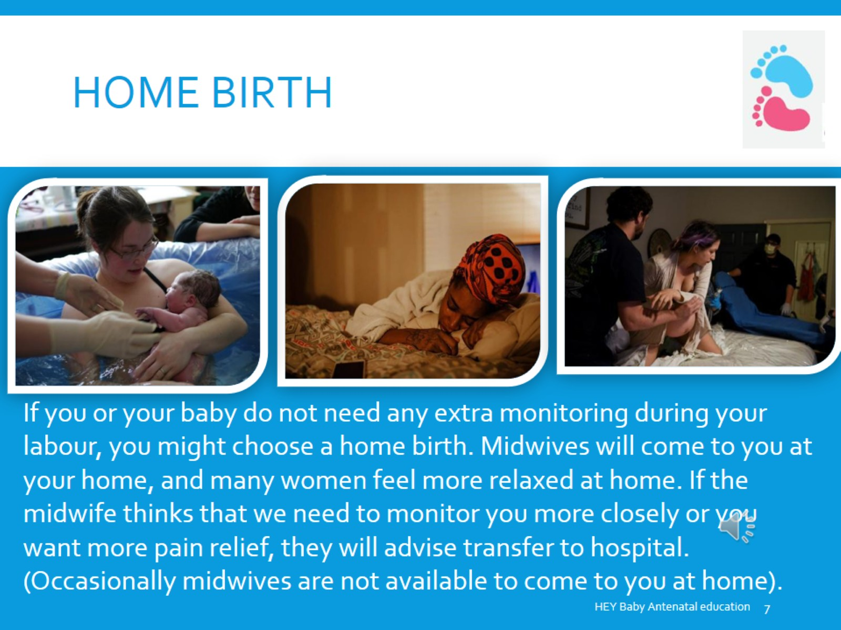
Home birth

Slide 8
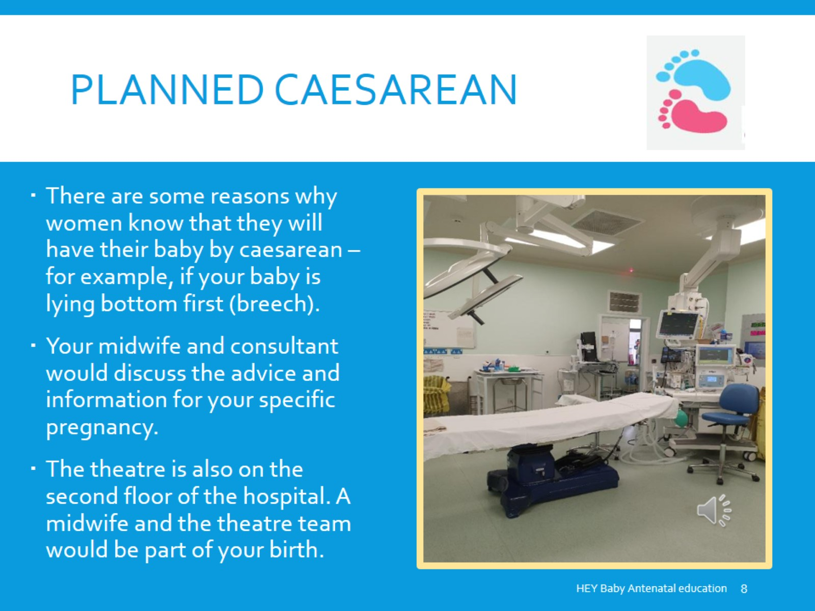
Planned caesarean

