Slide 1
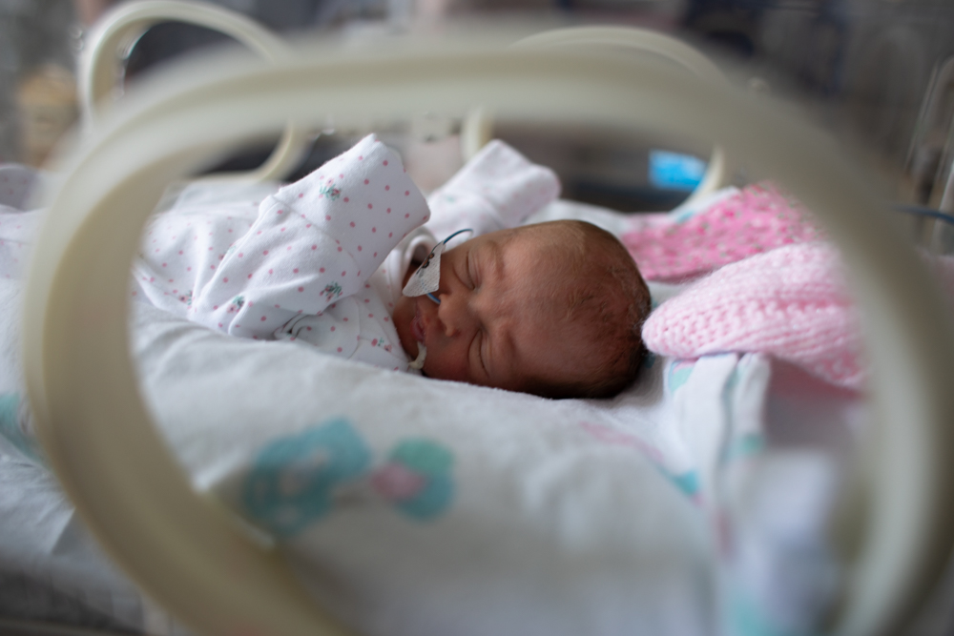
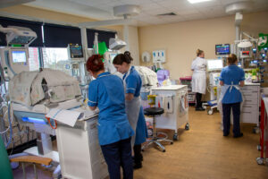
There are times when babies need to go to the neonatal unit after they are born
What is it?
The neonatal unit is a ward for babies who need extra care after they are born. It has nurses and doctors who are specialists in caring for newborn babies.
If the neonatal unit is full here, it is possible that it might be safer for you to be moved to a neonatal in a different hospital.
This video has some information about this:
https://youtu.be/CVbIdDypf3c?si=u0rbBz5C3O61xGcf
https://www.hey.nhs.uk/patient-leaflet/neonatal-intensive-care-unit-women-childrens-hospital-information-parents/

Slide 2
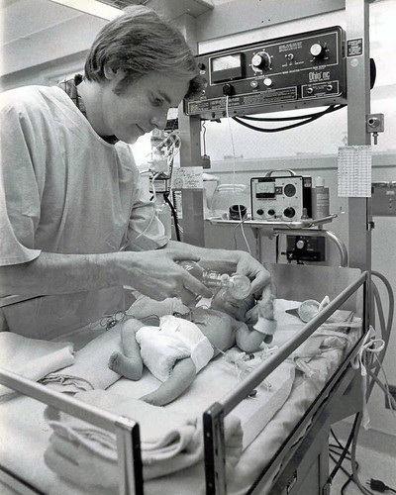
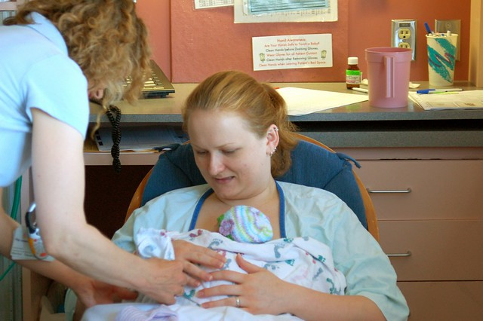
Why might my baby or babies need to go to the neonatal unit?
Infection
Being born early (pre-term)
Needing extra help breathing
Needing extra help keeping warm – temperature control
Extra help with feeding
Treatment for a health issue you spoke to paediatricians about before your baby was born
Did you know?......
1:8 babies will go to the neonatal unit.
This is often unexpected

Slide 3
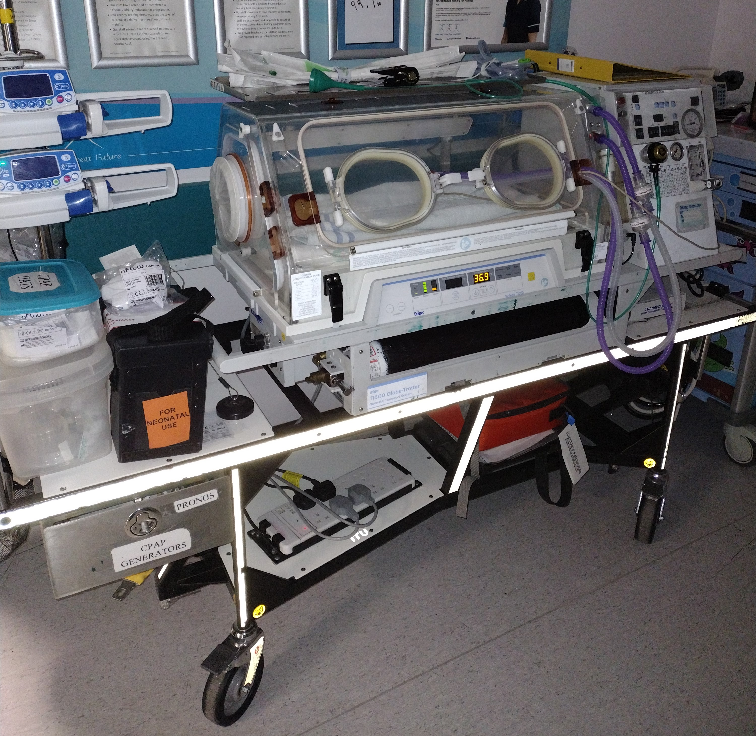
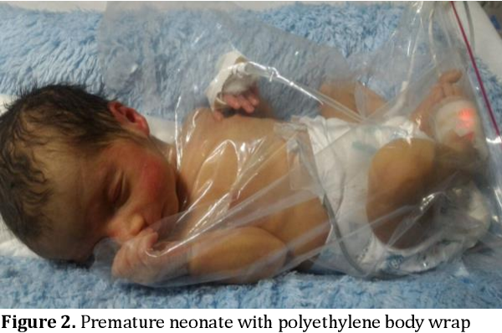
What might happen?
Babies are sometimes moved in incubators like this
Sometimes babies need to be taken straight to the neonatal unit as soon as they are born. Babies may stay there for a few hours, or they may stay for many weeks, depending on how much care they need.
On the unit they get special observations, tests and investigations and treatments.
Premature babies are often put into waterproof bags to keep them warm
https://www.humberandnorthyorkshirematernity.org.uk/labour-and-birth/neonatal-care/

Slide 4
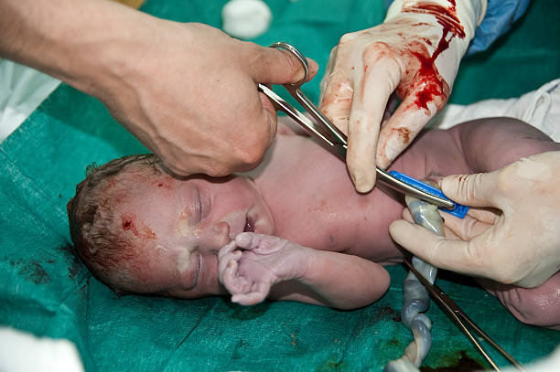
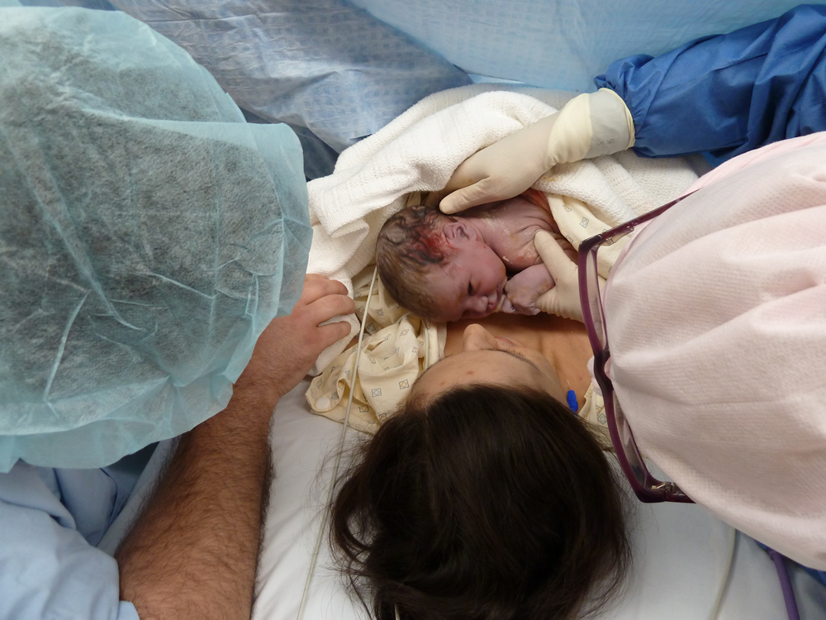
Often, your baby can be brought to you before they go to the neonatal unit. You will be able to visit your baby as soon as possible and your birth partner would be able to go to visit them as soon as they wish.
Sometimes, babies do not need to be moved to the neonatal unit straight away and you can still have skin to skin and your partner might still be able to cut the cord

Slide 5
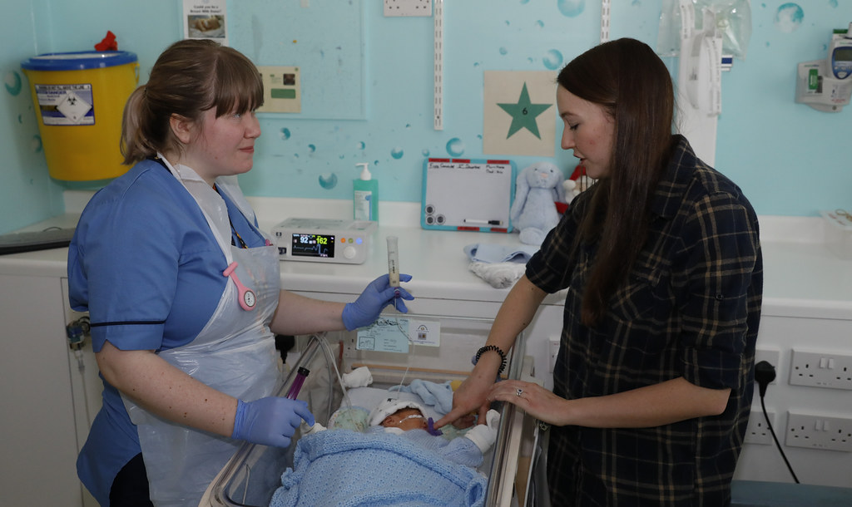
It is important to remember that you are still the parent so you will be able to be involved in your baby’s care as much as possible. This includes skin to skin, changing your baby’s nappies or feeding. You might need to change the way you do things. The staff will explain and show you.
Your milk is medicine
On the neonatal unit, breastmilk is used as a medicine.
It can help protect babies (especially babies born early) from infections.
It can help with brain development and help them get used to feeding earlier.
There are breast pumps available.
Tube Feeding
Sometimes a baby is not able to feed straight away.
A small tube is fed through the nose and into the baby’s stomach for milk to go slowly into the stomach.
You can tube feed your baby: the staff will teach you how.

Slide 6
Hull Neonatal Unit
The neonatal unit in Hull has four areas of care, depending on what a baby needs at the time.
Intensive care – This is the highest level of support for babies. Usually those born less than 28 weeks gestation will require this level of care, or babies who become unwell after birth. Babies who require intensive care may require ventilation with a breathing tube, surgery and food through their veins.
High dependency – this is for babies who require support with breathing through pressure masks to help their own breathing and will need closer observation. They may have stepped down from intensive care to high dependency.
Special care – This is where babies are getting feeding support with feeding tubes and starting to breast/bottle feed. Babies in this area are usually above 32 weeks gestation and may need help with temperature control and low blood sugars.
Transitional care – Babies and parents are cared for together here. Babies are typically over 34 weeks gestation and usually need support with establishing feeding, temperature control and jaundice.

