Slide 1







Falls Prevention
Falls Prevention Team HUTH
Falls History: Talk to staff about concerns around Falls, my history of falls and my fear around falling.
Do I need: support with drinking? Can my carer bring in drinks for me? Speak to nursing team regarding fluid intake.
Do I need: support with nutrition? Can my carer bring snacks? Ask about ward snacks. Do I have special dietary requirements staff need to know?
Mobility: Do I use a walking aid at home? Have you brought it in? Can your carer bring it in? Please do not use hospital furniture as a walking aid.
Deconditioning: We encourage all our patients to “Get Up Get Dressed and Keep Moving” whilst in hospital as much as they are able.
Toilets: Do I know were the toilet is? Do I need help to access toilet facilities? Staff are happy to help with access and return journey.

Slide 2





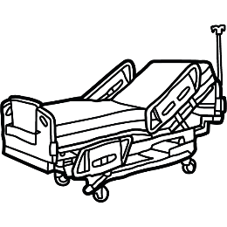
Falls Prevention
Falls Prevention Team HUTH
Do I have: My own well fitting footwear with me? Can someone bring them in for me?
Do I need: Glasses or hearing aids? Inform staff if they are not with you. Can someone bring them from home?
Nurse Call: Please press your nurse call bell/buzzer if you need anything. Staff are happy to assist or answer questions.
Dizziness: Do I feel dizzy when I get up? Have I informed nursing team? Stand up/sit down slowly.
Bed Height: All beds should allow for feet to be flat on floor, without undue pressure on back of knees (Popliteal height)
Bed Rails: Bed rails, also known as side rails or cot sides, are widely used to reduce the risk of falls. Although not suitable for everyone, they can be very effective when used for right bed, right way, right person.

